Slide 1
SOFTWARE PROJECT
LAB-1

Slide 2
Project name :
Equation Solver & Plotter
Presented by:
Amit Kumar Roy
Roll: 1314
Supervised by:
Kishan Kumar Ganguly
Assistant Professor
IIT, DU

Slide 3
Overview
This project will perform these operations:
Linear Equation Solve
Linear Equation Solution Process
Linear & Polynomial Function’s Graph Plot
Polynomial Equation Solve
Polynomial Equation Solution Process

Slide 4
Project flow Diagram
EQUATION SOLVER & PLOTTER
LINEAR EQUATION SOLVE
LINEAR EQUATION SOLUTION PROCESS
POLYNOMIAL EQUATION SOLVE
POLYNOMIAL EQUATION SOLUTION PROCESS
LINEAR & POLYNOMIAL FUNCTION GRAPH
Input Equation
Implement Cramer’s Rule & Show all intermediate steps
Make solution using Bairstow Algorithm
Input Equation
Calculate Points
Tokenize & parse terms
Plot Points
Create matrix
Algebraic Operation
Show Intersects Points
Find Determinant
Process Linear Equation
Solve using Cremers rule
Use Remainder Theorem

Slide 5
Algorithms are used here:
Row Reduction Method
Cramer’s Method
Bairstow Method
Syntactic Division Method
Remainder theorem Algorithm

Slide 6

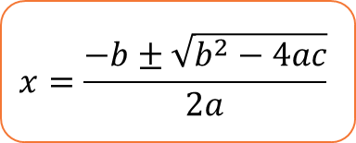
Bairstow Algorithm
Input Equation
A₁X^{n}+A₂X^{n-1}+……..+A_{n-1}X + A_{n}
Divide polynomial equation by a quadratic equation
(A₁X^{n}+A₂X^{n-1}+……..+A_{n-1}X + A_{n} ) / (aX²+bX+c)
Remainder=0
aX²+bX+c
No
yes
yes
A₁X^{n-2}+A₂X^{n-3}+……..+A_{n-3}X + A_{n-2}
Two roots

Slide 7
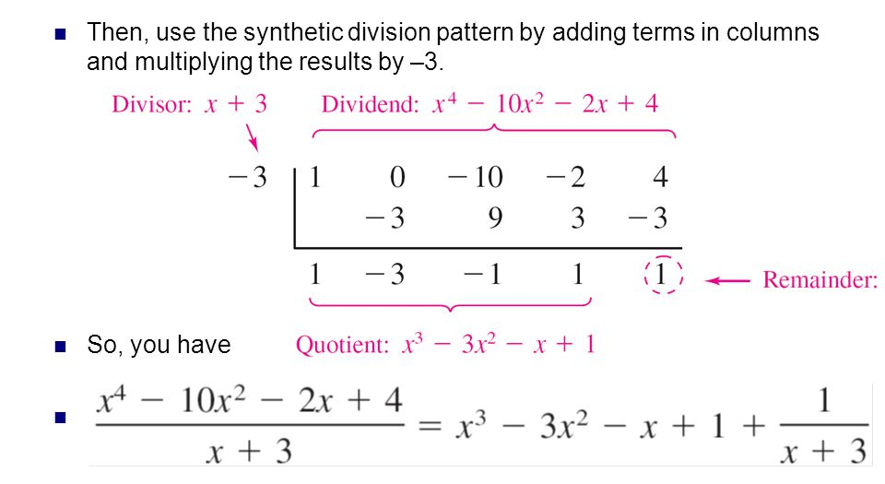
Remainder Theorem ( Synthetic division)

Slide 8


Tool used
Tools used
Language: C+ Project stored Line of code
2500+
Github link: https://github.com/AmitRoy01/SPL-1

Slide 9
Thank you!

